Slide 1
C♯ Putting it all together
Rasmus Lystrøm
Associate Professor
ITU
rnie@itu.dk

Slide 2
Agenda
Error handling in Xamarin.Forms
Security – authentication / authorization
DevOps
Continuous Integration/Delivery/Deployment (Azure DevOps)
Trunk Based development
Branching strategy vs. tactics
Infrastructure as Code

Slide 3
Error Handling in Xamarin.Forms

Slide 4

Error handling in Xamarin.Forms
The exception to the rule
try/catch → log
Image Source: https://bizshifts-trends.com/cracking-enigma-the-exception-that-proves-the-rule-its-nonsense-absurd-or-an-unlikely-defense/

Slide 5
Security

Slide 6

Authentication and Authorization options
(No Authentication)
(Invidual User Accounts)
Azure Active Directory B2C
Work or School Accounts (Azure Active Directory)
Windows Authentication (AD)
Azure App Service Authentication (easyauth.dll)
Don’t write your own security layer!
Image source: http://lazergaze.tumblr.com/post/26333564955

Slide 7
Security in ASP.NET Core Web API
Demo

Slide 8
Security in Xamarin.Forms
https://portal.azure.com/
Create new App Registration
https://azure.microsoft.com/en-us/resources/samples

Slide 9
Security in Xamarin.Forms
Demo

Slide 10
DevOps

Slide 11
DevOps
DevOps is a set of practices that automates the processes between software development and IT teams, in order that they can build, test, and release software faster and more reliably. The concept of DevOps is founded on building a culture of collaboration between teams that historically functioned in relative siloes.
Source: https://www.atlassian.com/devops

Slide 12

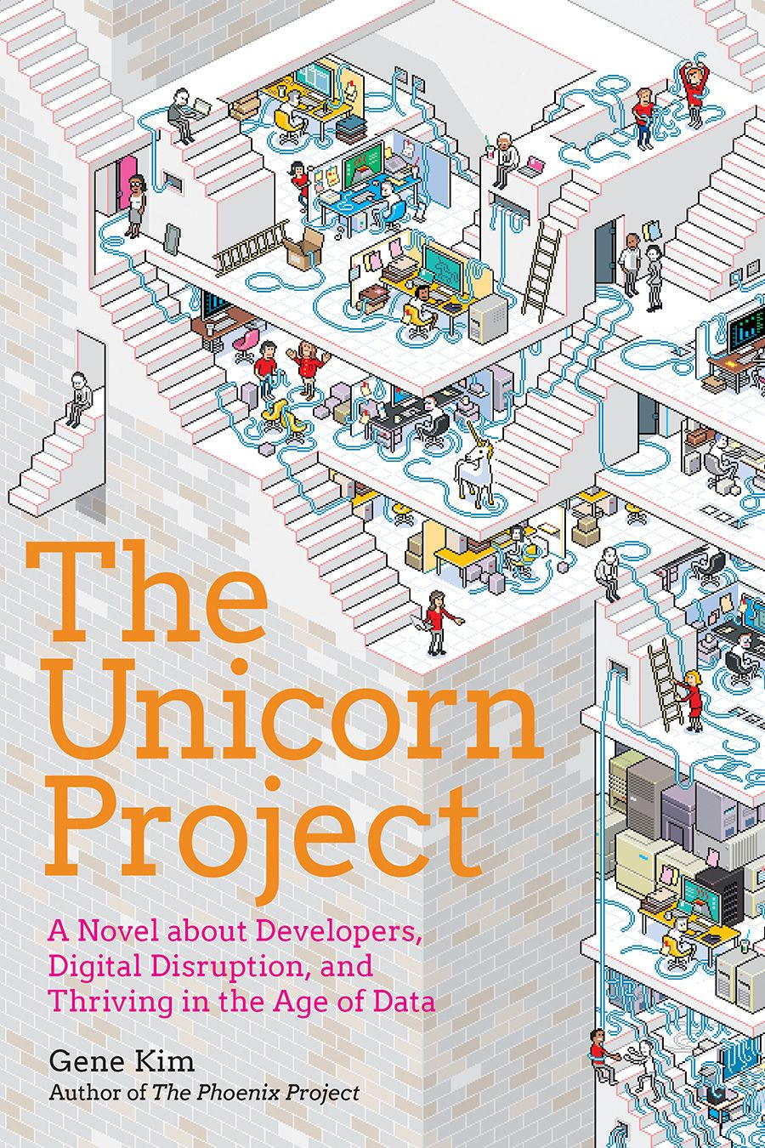
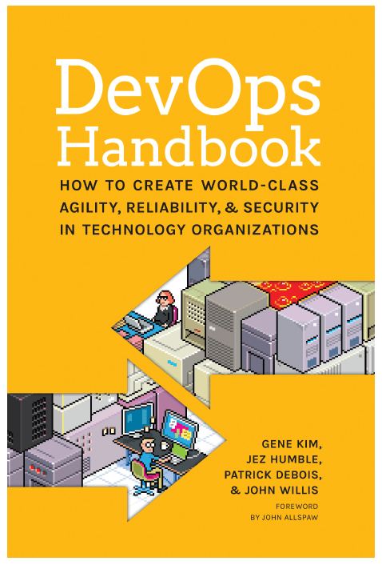
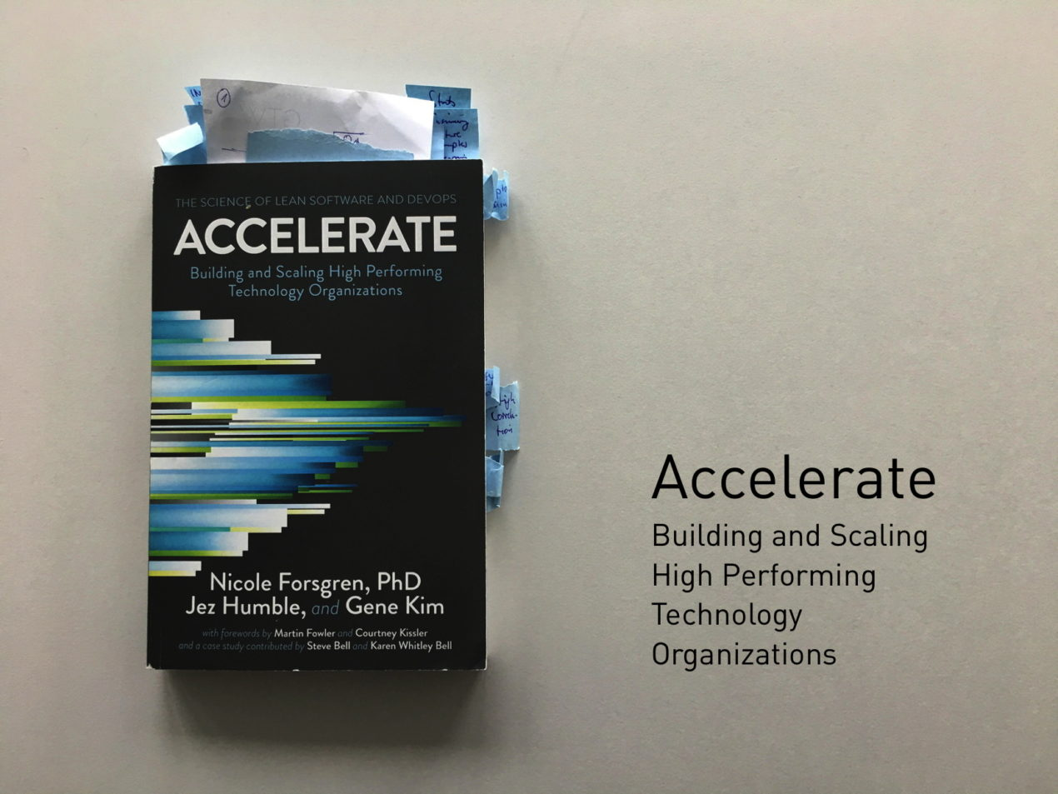
Books

Slide 13
Continuous Integration

Slide 14
Continuous Integration
Continuous integration (CI) is the practice of automating the integration of code changes from multiple contributors into a single software project. The CI process is comprised of automatic tools that assert the new code's correctness before integration.

Slide 15
Trunk Based Development

Slide 16
Trunk Based Development
A source-control branching model, where developers collaborate on code in a single branch called ‘trunk’ *, resist any pressure to create other long-lived development branches by employing documented techniques. They therefore avoid merge hell, do not break the build, and live happily ever after.
* master, in Git nomenclature
Source: https://trunkbaseddevelopment.com/

Slide 17
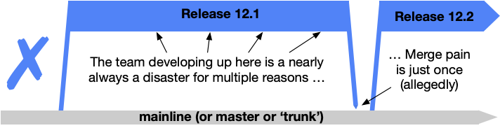
Shared branches off mainline/master/trunk are bad at any release cadence

Slide 18
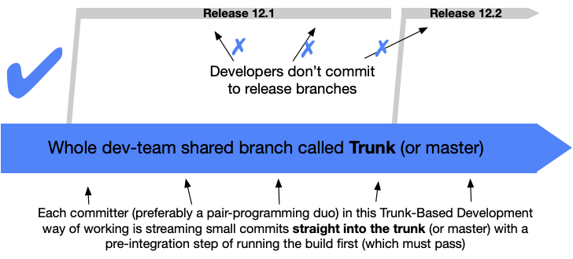
Trunk Based Development

Slide 19
Branching strategy vs. tactics
Short-lived < 1 day
No strategy!

Slide 20

Azure DevOps

Slide 21
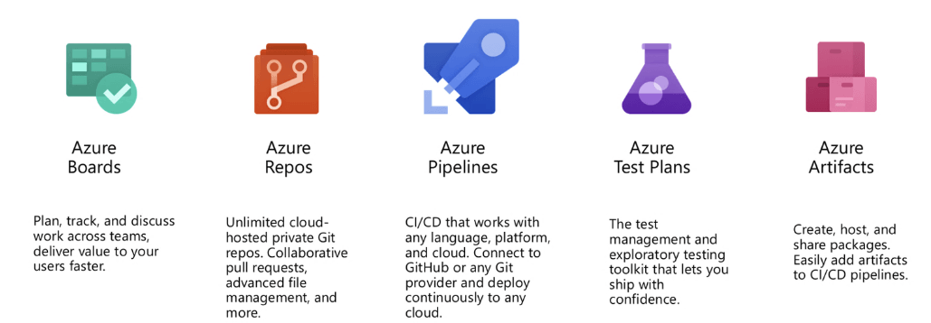
Azure DevOps

Slide 22
Azure DevOps
Demo

Slide 23
Continuous Integration Trunk Based Development
Demo

Slide 24
Continuous Delivery

Slide 25
Continuous Delivery
Continuous delivery is an approach where teams release quality products frequently and predictably from source code repository to production in an automated fashion.

Slide 26
Continuous Deployment

Slide 27
Infrastructure as Code

Slide 28
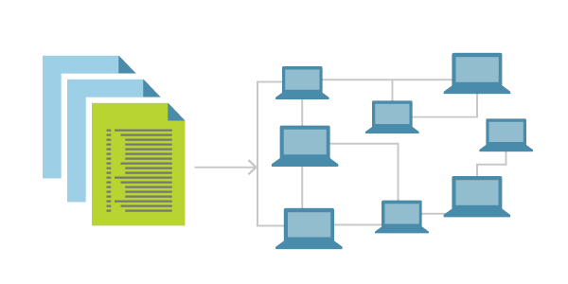
Infrastructure as Code
Infrastructure as Code (IaC) is the management of infrastructure (networks, virtual machines, load balancers, and connection topology) in a descriptive model, using the same versioning as DevOps team uses for source code.
Idempotent
IaC is a key DevOps practice and is used in conjunction with CD
Source: https://docs.microsoft.com/en-us/azure/devops/learn/what-is-infrastructure-as-code

Slide 29

Infrastructure as Code Tools for Microsoft Azure
Azure PowerShell
Azure CLI
ARM Templates
Terraform

Slide 30
Continuous Delivery and Deployment Infrastructure as Code
Demo

